Slide 1

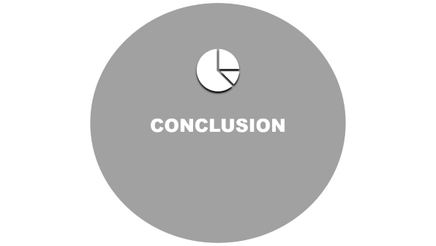


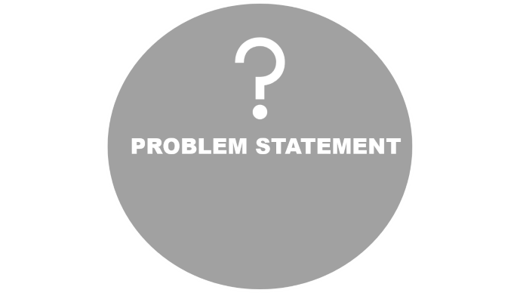

Slide 2

PROBLEM STATEMENT

Slide 3


PROBLEM STATEMENT
Sales management has gained importance to meet increasing competition and the need for improved methods of distribution to reduce cost and to increase profits. Sales management today is the most important function in a commercial and business
enterprise.

Slide 4

DATA COLLECTION

Slide 5


DATA COLLECTION
Column Names and Description:
Region: The geographical region where the sales occurred.
Country: The specific country within the region.
Item Type: The type of item sold
Sales Channel: The channel through which the sales were made
Order Priority: The priority level of the order
6. Order Date: The date when the order was placed.
Order ID: A unique identifier for each order.
Ship Date: The date when the order was shipped.
Units Sold: The number of units sold in the order.
Unit Price: The price per unit of the item sold.
Unit Cost: The cost per unit of the item sold.
Total Revenue: The total revenue generated.
Total Cost: The total cost associated with the order.
Total Profit: The total profit generated from the order.

Slide 6

INSIGHTS

Slide 7



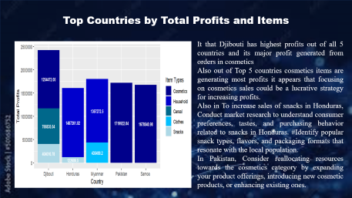
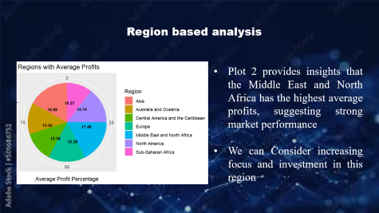
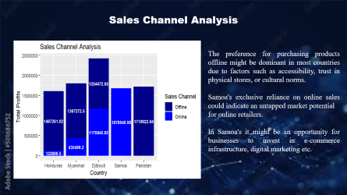
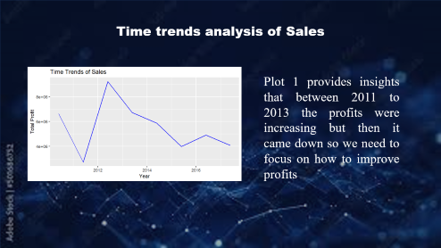
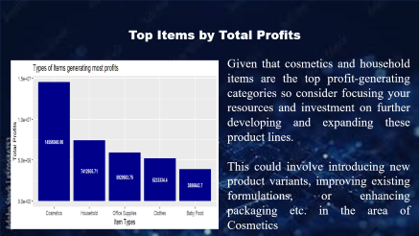
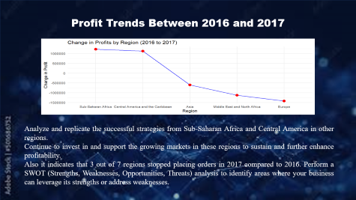
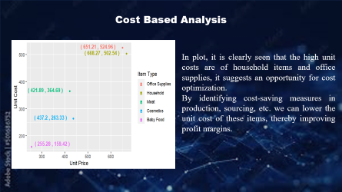
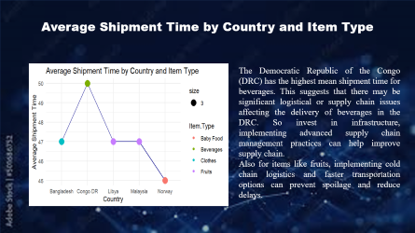
INSIGHTS

Slide 8

INSIGHTS

Slide 9

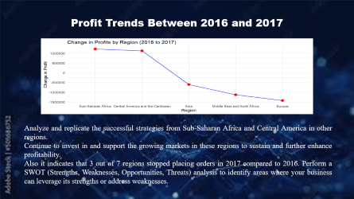
INSIGHTS

Slide 10
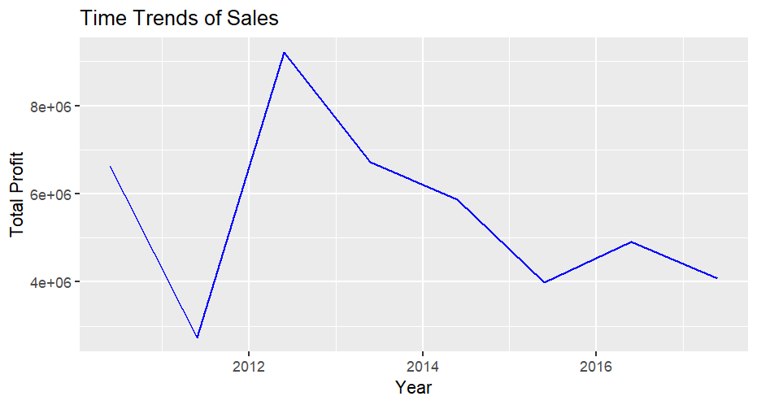
Time trends analysis of Sales
Plot 1 provides insights that between 2011 to 2013 the profits were increasing but then it came down so we need to focus on how to improve profits

Slide 11
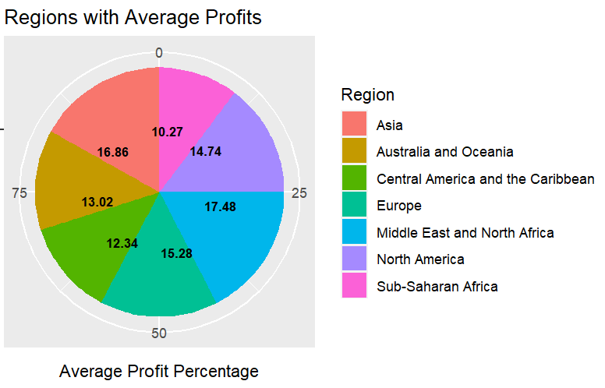
Region based analysis
Plot 2 provides insights that the Middle East and North Africa has the highest average profits, suggesting strong market performance
We can Consider increasing focus and investment in this region

Slide 12
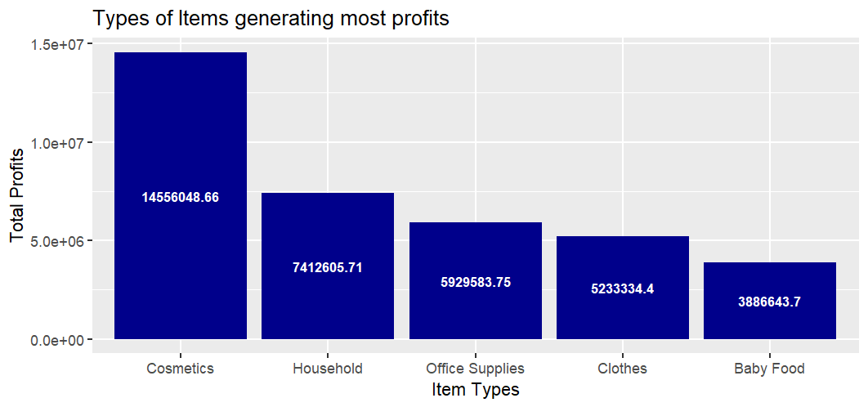
Top Items by Total Profits
Given that cosmetics and household items are the top profit-generating categories so consider focusing your resources and investment on further developing and expanding these product lines.
This could involve introducing new product variants, improving existing formulations, or enhancing packaging etc. in the area of Cosmetics

Slide 13
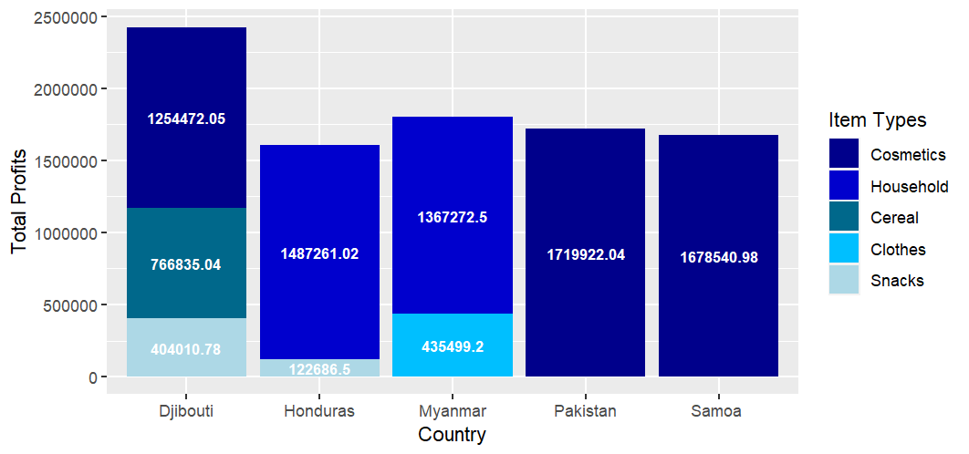
Top Countries by Total Profits and Items
It that Djibouti has highest profits out of all 5 countries and its major profit generated from orders in cosmetics
Also out of Top 5 countries cosmetics items are generating most profits it appears that focusing on cosmetics sales could be a lucrative strategy for increasing profits.
Also in To increase sales of snacks in Honduras, Conduct market research to understand consumer preferences, tastes, and purchasing behavior related to snacks in Honduras. #Identify popular snack types, flavors, and packaging formats that resonate with the local population.
In Pakistan, Consider reallocating resources towards the cosmetics category by expanding your product offerings, introducing new cosmetic products, or enhancing existing ones.

Slide 14
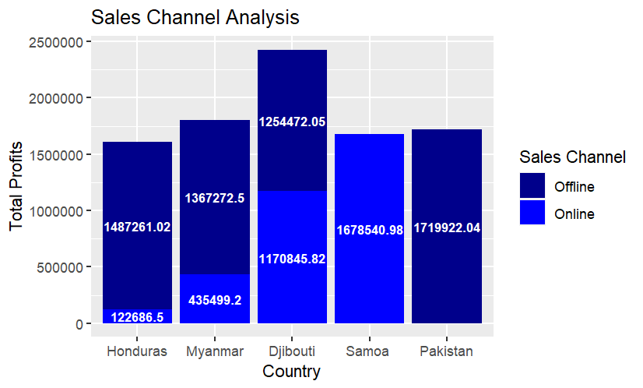
Sales Channel Analysis
The preference for purchasing products offline might be dominant in most countries due to factors such as accessibility, trust in physical stores, or cultural norms.
Samoa's exclusive reliance on online sales could indicate an untapped market potential
for online retailers.
In Samoa's it might be an opportunity for businesses to invest in e-commerce infrastructure, digital marketing etc.

Slide 15
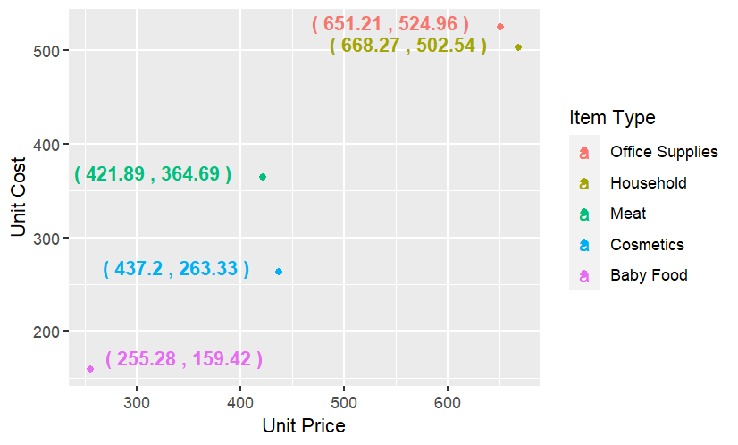
Cost Based Analysis
In plot, it is clearly seen that the high unit costs are of household items and office supplies, it suggests an opportunity for cost optimization.
By identifying cost-saving measures in production, sourcing, etc. we can lower the unit cost of these items, thereby improving profit margins.

Slide 16
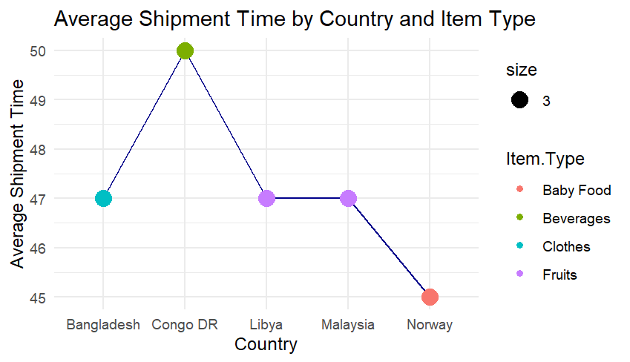
Average Shipment Time by Country and Item Type
The Democratic Republic of the Congo (DRC) has the highest mean shipment time for beverages. This suggests that there may be significant logistical or supply chain issues affecting the delivery of beverages in the DRC. So invest in infrastructure, implementing advanced supply chain management practices can help improve supply chain.
Also for items like fruits, implementing cold chain logistics and faster transportation options can prevent spoilage and reduce delays.

Slide 17
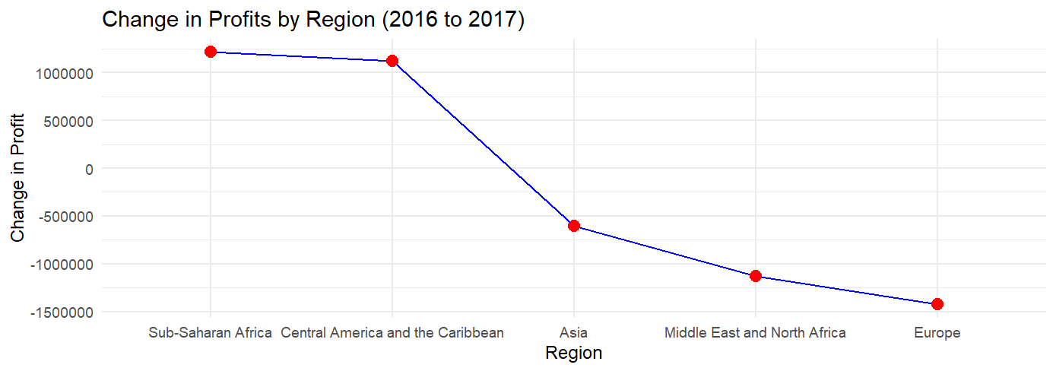
Profit Trends Between 2016 and 2017
Analyze and replicate the successful strategies from Sub-Saharan Africa and Central America in other regions.
Continue to invest in and support the growing markets in these regions to sustain and further enhance profitability.
Also it indicates that 3 out of 7 regions stopped placing orders in 2017 compared to 2016. Perform a SWOT (Strengths, Weaknesses, Opportunities, Threats) analysis to identify areas where your business can leverage its strengths or address weaknesses.

Slide 18

CONCLUSION

Slide 19

CONCLUSION
In summary, the analysis underscores the importance of strategic interventions to boost profitability and market performance. Key findings suggest a declining profit trend post-2013, with opportunities identified in regions like the Middle East and product categories such as cosmetics and household items. Djibouti emerges as a leader in profitability, particularly in cosmetic sales, highlighting potential avenues for product expansion. Targeted strategies, including market research in Honduras and resource reallocation in Pakistan, can optimize sales. Additionally, cost optimization and addressing logistical challenges are crucial for sustainable growth. Leveraging online sales channels, especially in regions like Samoa, presents untapped potential. Overall, a strategic approach tailored to regional dynamics and product categories is essential for driving profitability and market expansion.

